Slide 1

Hotel Reservation Analysis
Presented By Abderrahim Haddeji
Mentorness Batch: MIP-DA-10

Slide 2

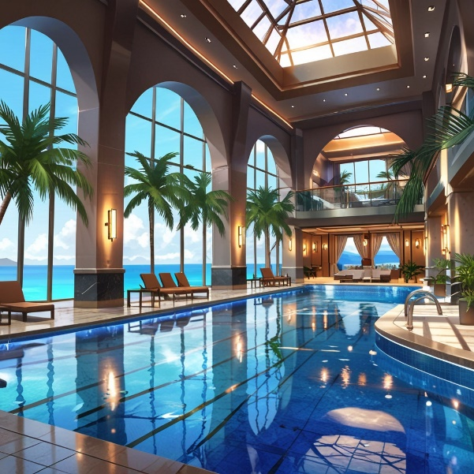


the summery of project
The hotel industry relies on data to make well-informed decisions and elevate the guest experience. The goal of this project is to uncover insights into guest preferences, booking patterns, and other critical factors that impact hotel operations by analyzing a comprehensive dataset of hotel reservations. Our plan is to rely on SQL to query and analyze the data, answering specific questions and generating meaningful conclusions from the dataset.

Slide 3
Dataset Details:
The dataset includes the following columns:
Booking_ID: A unique identifier for each hotel reservation.
no_of_adults: The number of adults in the reservation.
no_of_children: The number of children in the reservation.
no_of_weekend_nights: The number of nights in the reservation that fall on weekends.
no_of_week_nights: The number of nights in the reservation that fall on weekdays.
type_of_meal_plan: The meal plan chosen by the guests.
room_type_reserved: The type of room reserved by the guests.
lead_time: The number of days between booking and arrival.
arrival_date: The date of arrival.
market_segment_type: The market segment to which the reservation belongs.
avg_price_per_room: The average price per room in the reservation.

Slide 4
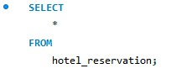
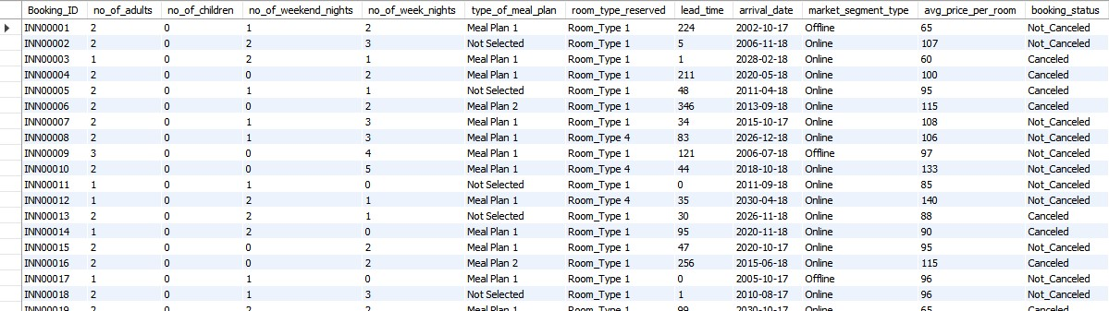
The overall dataset

Slide 5
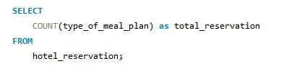
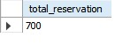
Query1: what is the total number of reservations in the dataset?
Insights:
700 reservations are present in the dataset.

Slide 6
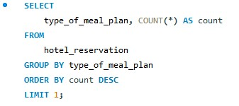
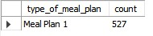
Query 2 : which meal plan is the most popular among guests?
Insights:
Meal Plan 1 is the most commonly chosen choice by guests with count of 527.

Slide 7
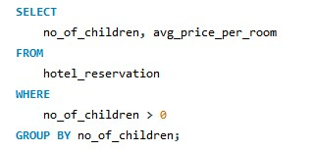
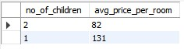
Query 3: What is the average price per room for reservations involving children?
Insights:
The average room rate for bookings including one child is 131, while the average rate for bookings with two children is 82.

Slide 8
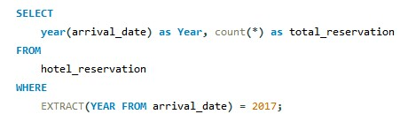
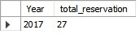
Query 4. How many reservations were made for the year 20XX (replace XX with the desired year)?
Insights:
27 reservations were made in 2017

Slide 9
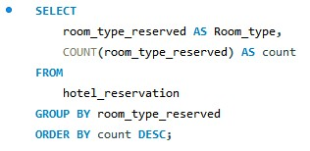
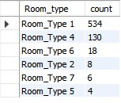
Query 5. What is the most commonly booked room type?
Insights:
The Room_Type 1 is the most popular choice for guests when making their reservations.

Slide 10
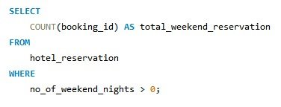
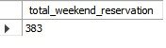
Query 6. How many reservations fall on a weekend (no_of_weekend_nights > 0)?
Insights:
There are 383 reservations made for weekend nights.

Slide 11
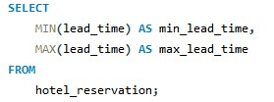
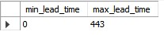
Query 7. What is the highest and lowest lead time for reservations?
Insights:
Guest booking behaviors can be inferred from the range of lead times, which ranges between 0 and 443 days.

Slide 12
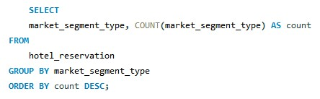
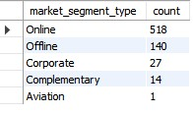
Query 8. What is the most common market segment type for reservations?
Insights:
The online type has the most reservation types, with a total count of 518.
The majority of individuals prefer to book through the Internet over other methods, such as offline, corporate, complementary, and aviation.

Slide 13
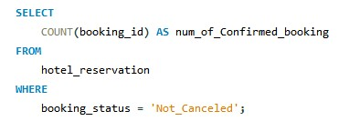
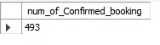
Query 9. How many reservations have a booking status of "confirmed"?
Insights:
Our confirmation rate for reservations has reached more than 70%, with 493 out of 700 confirmed. This shows that a significant number of successful reservations have been confirmed.

Slide 14
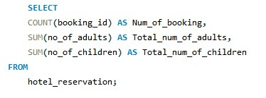
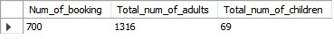
Query 10. What is the total number of adults and children across all reservations ?
Insights:
Adult guests are the majority of reservations with 1,316, while children are present in only 69. It's clear that the hotel's primary target audience is adults.

Slide 15
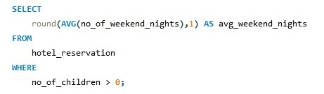
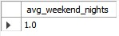
Query 11: What is the average number of weekend nights for reservations involving children?
Insights:
The majority of child-related reservations are for a one-night stay on weekends, Families tend to choose to stay at the hotel on weekends, possibly due to the availability of appropriate entertainment options

Slide 16
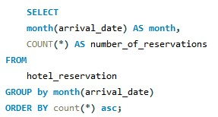
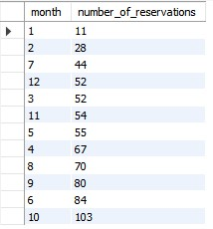
Query 12: how many reservations were made in each month of the year?
Insights:
It's clear that October is the most popular month for reservations, with 103 total reservations, followed by June with 84 and September with 80.
January had the fewest reservations, totaling only 11, indicating a quieter period.

Slide 17
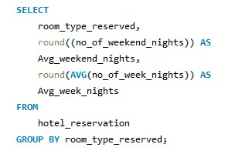
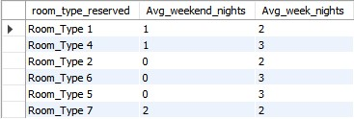
Query 13: What is the average number of nights (both weekend and weekday) spent by guests for each room type?
Insights: Room Type 4 guests generally spend an average of 3 nights, while Room Type 2 guests usually spend just 2 nights.

Slide 18
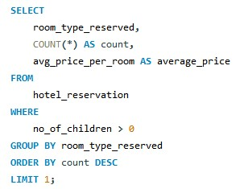
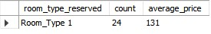
Query 14: for reservations involving children, what is the most common room type, and what is the average price for that room type?
Insights: Room Type 1 is the top choice for bookings with children, with an average room rate of $123.12. It's possible that this type of room attracts more children, or that children have a natural preference for the first number

Slide 19
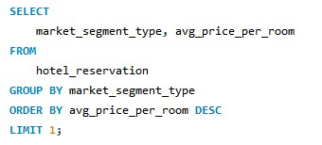
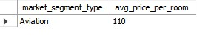
Query 15: find the market segment type that generates the highest average price per room.
Insights:
The highest average room price is generated by aviation bookings, with 110.

Slide 20


